Slide 1
Online Jewelry Rental System
www.collaberadigital.com

Slide 2
Key Takeaways/Learnings from the Program.
Learned more on how to develop .NET Core MVC Web App and how it works:
How to connect with SQL Server.
Downloading necessary packages for creating web app.
Downloading and using Entity Framework core, design, tools, etc. on the project.
Develop a system with the use of ASP .NET Core Identity.

Slide 3
Problem Statement of the Capstone Project
The capstone project intends to find an answer on how to make the customers on specific jewelry shop have a choice to browse jewelry online and rent, or to have an appointment on specific branch and rent.
How to design a user-friendly interface for Online Jewelry Rental System?
How to design a system or web app that makes the process easier for appointing and renting a jewelry for both customer and employee?
How to design an easy to use account management system for the admin.

Slide 4
Scope and Delimitation
Scope:
- The proposed system has three modules: Admin, Employee, and the Customer.
- The proposed system can create an account for the employees.
- The proposed system has a registration page where new users can create their own account.
- The proposed system can provide the viewing of available jewelries.
- The proposed system can generate Transaction ID.
- The proposed system can appoint schedule for users to rent a specific jewelry.
- The proposed system can only appoint 3 users that's been scheduled on the same day.
Delimitations:
- The system does not include payroll, accounting, marketing, sales and other management system.
- The customers does not have any access to the database and creation of admin and employees account.

Slide 5
Approach Note
(How the candidate approached the program)
Agile
Agile offers a rapid process and flexibility that makes it one of the most popular methodologies. In the Agile approach, the software development team completes work in short periods, like a few weeks. This process uses what developers call fast failure to revise and test as they go through new iterations of the software.
That means the real life cycle of Agile development looks more like this:
Project planning
Product roadmap creation
Release planning
Sprint planning
Daily meetings
Sprint Review
Reference:
8 Software Development Life Cycle Methodologies To Consider | Indeed.com

Slide 6
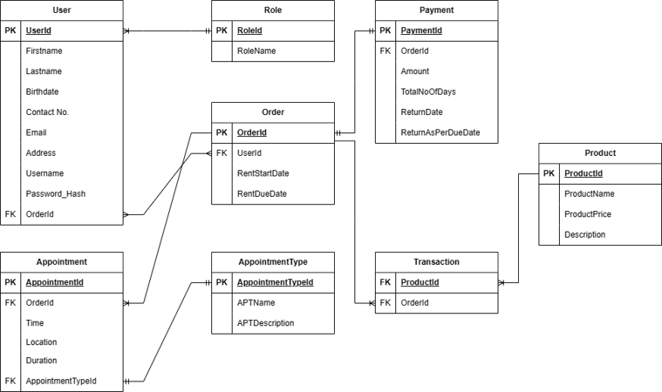
Entity Relationship Diagram

Slide 7

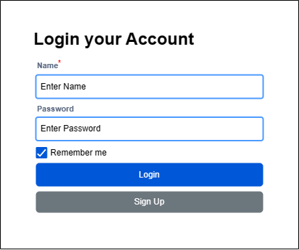

Wireframe/Architecture
www.collaberadigital.com

Slide 8
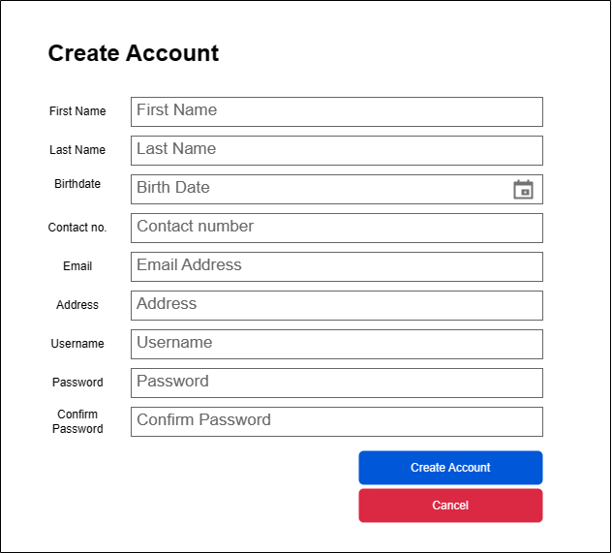
Wireframe/Architecture
www.collaberadigital.com

Slide 9
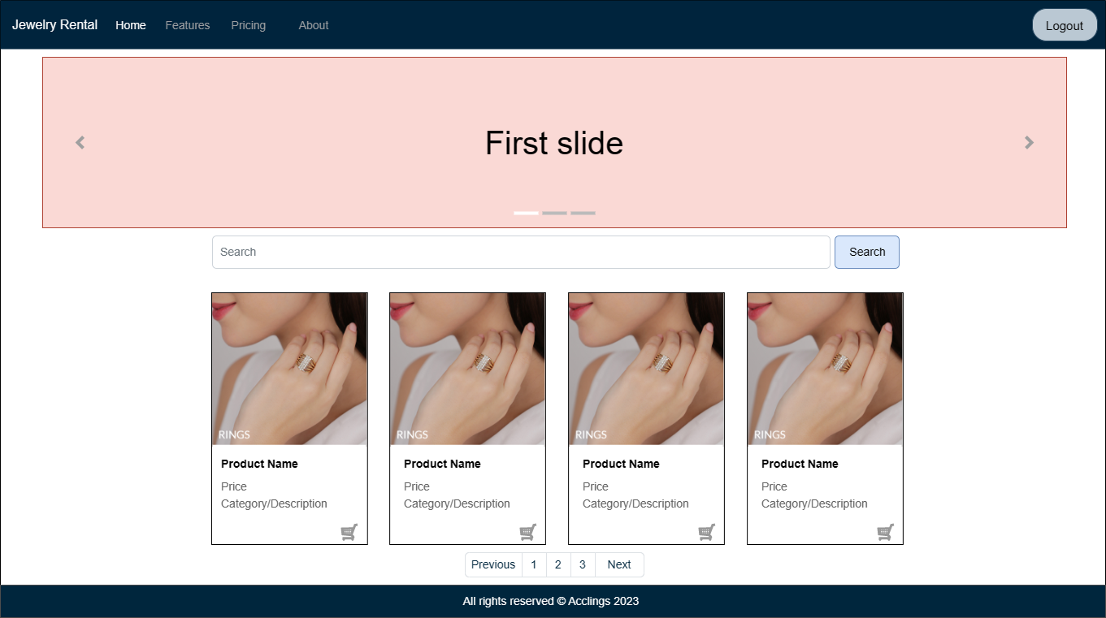
Wireframe/Architecture
www.collaberadigital.com

Slide 10
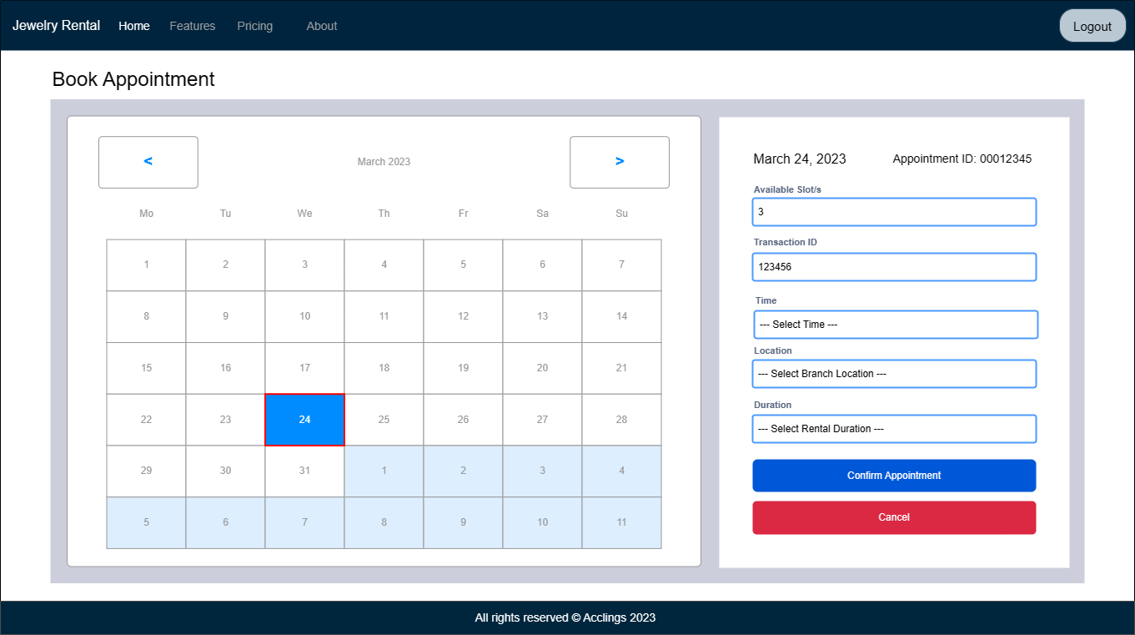
Wireframe/Architecture
www.collaberadigital.com

Slide 11
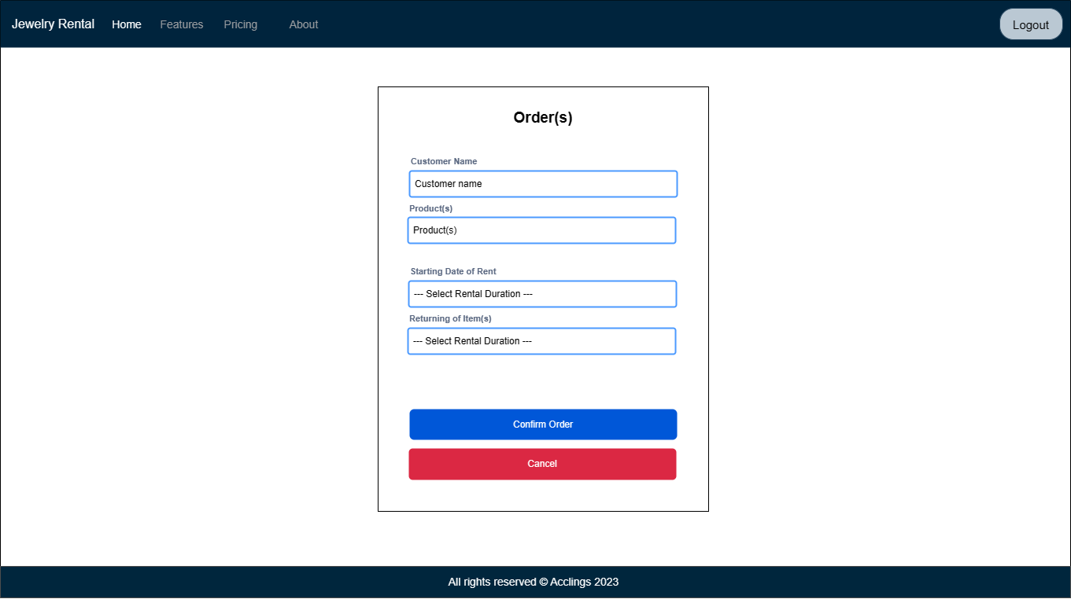
Wireframe/Architecture
www.collaberadigital.com

Slide 12
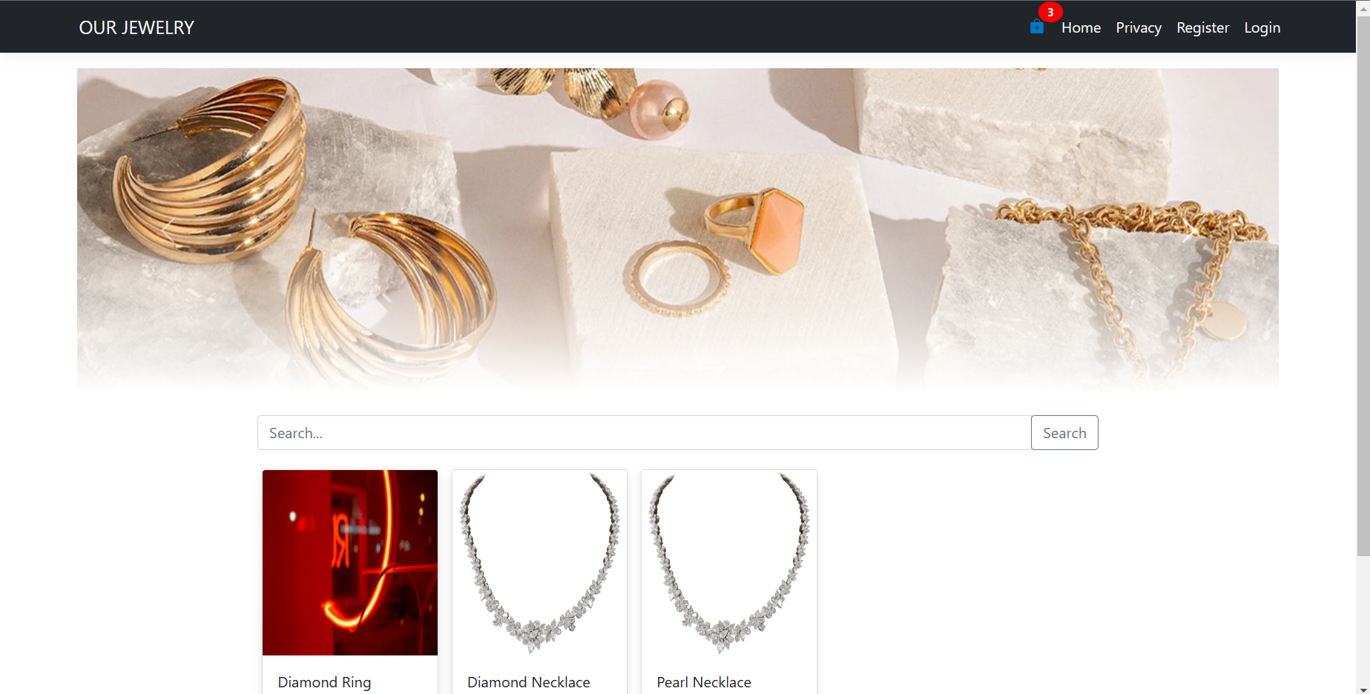
WEB APPLICATION
www.collaberadigital.com

Slide 13
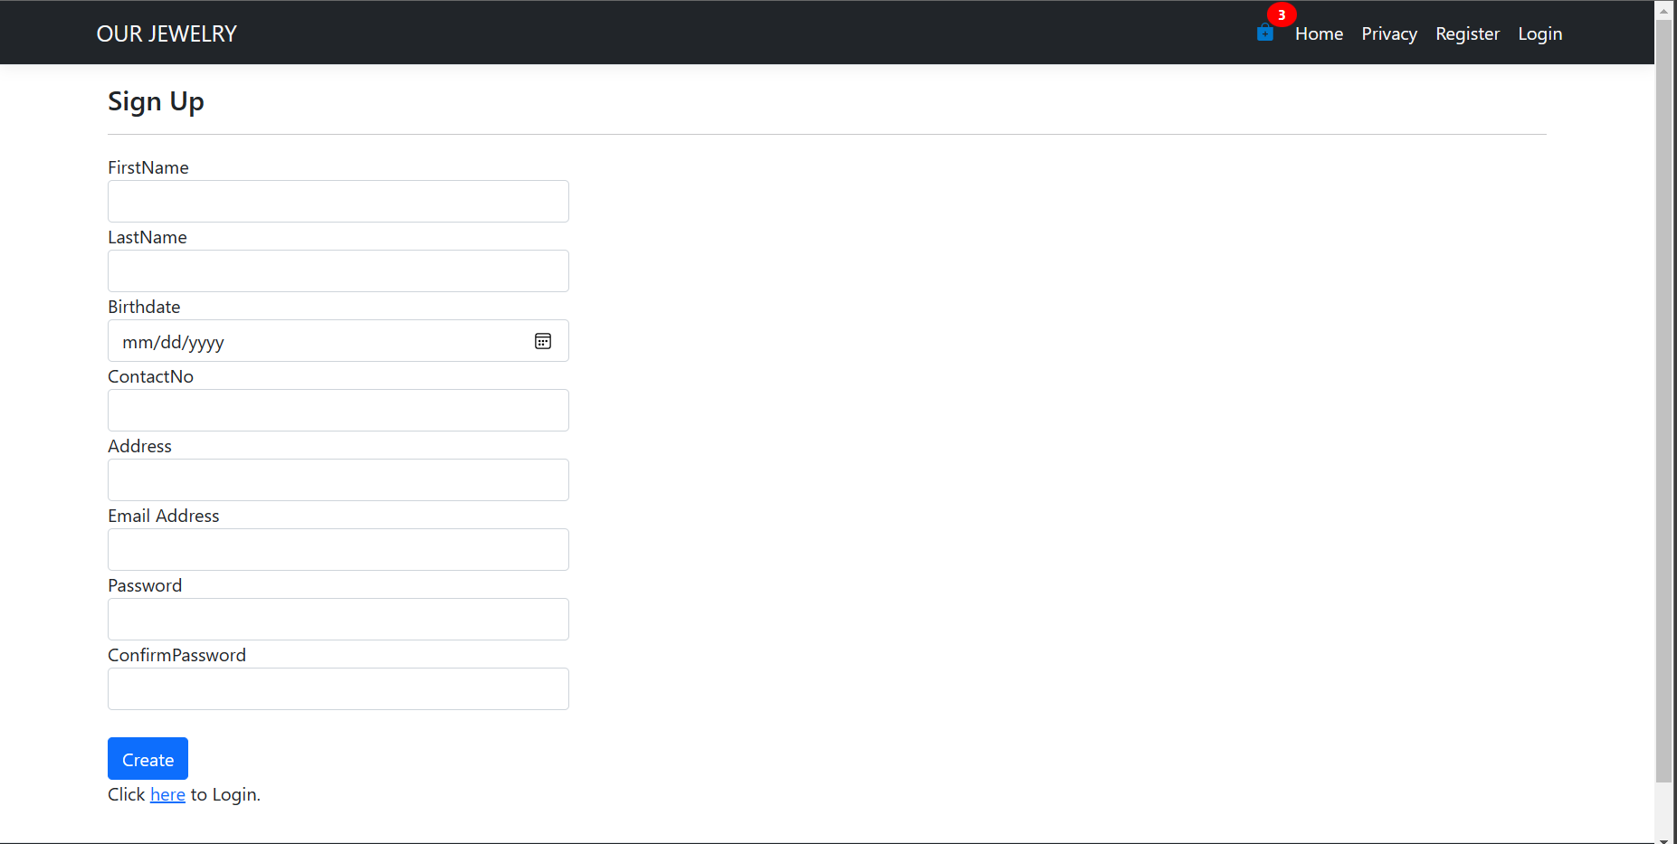
WEB APPLICATION

Slide 14
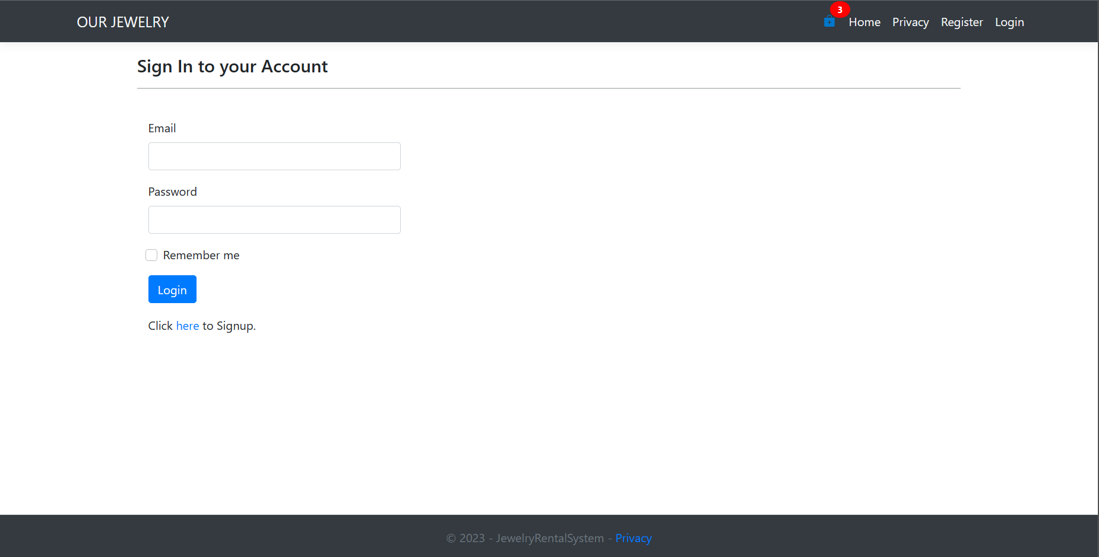
WEB APPLICATION

Slide 15
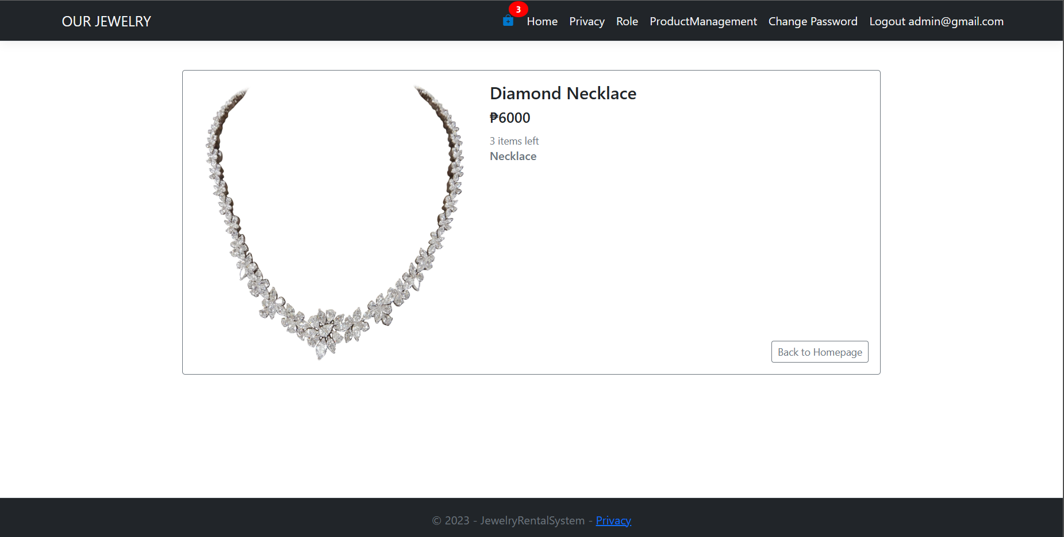
WEB APPLICATION

Slide 16
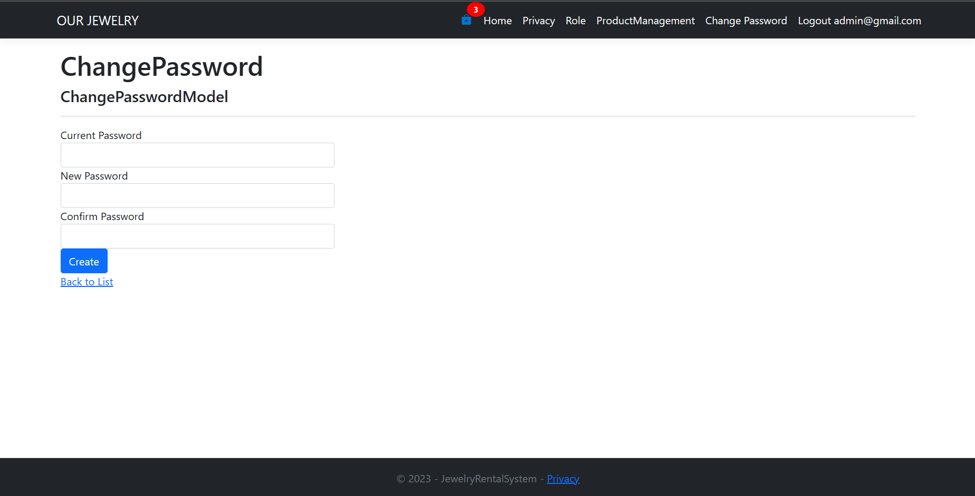
WEB APPLICATION

Slide 17
To be Completed or [Known Issues]:
Appointment Scheduling
Add to cart
Transactions
Payment
User Interface design
Kubernetes Deployment
Docker Containerization

Slide 18
Conclusion
Developed a user-friendly interface for Online Jewelry Rental System that would benefit both shop and the customers.
Design a system or web app that makes the process easier for appointing and renting a jewelry for both customer and employee.
Design an easy to use account management system for the Admin.

Slide 19
Thank You
www.collaberadigital.com

